Slide 1
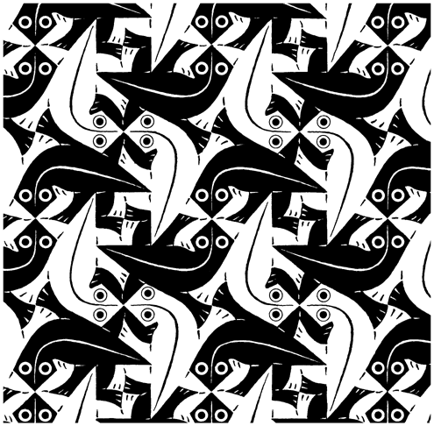
Tessellations

Slide 2
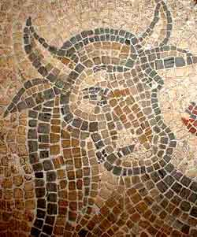
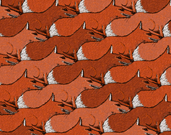
What is a tessellation?
A collection of shapes that fit together to cover a surface without overlapping or leaving gaps. Often a repeating geometric pattern,
Tessellations can be seen in almost every brick wall, tiled floor or wall, quilt pattern, lace tablecloth, fabric and wallpaper pattern.
The word tessellation comes from the latin word “tessera” which means small stone cube
The earliest tessellations were found as mosaic pictures on floors in old roman buildings
Nowadays, the term "tessellation" has become more specialized. Its meaning has changed. The individual tiles are the shape of animals, people, and things

Slide 3
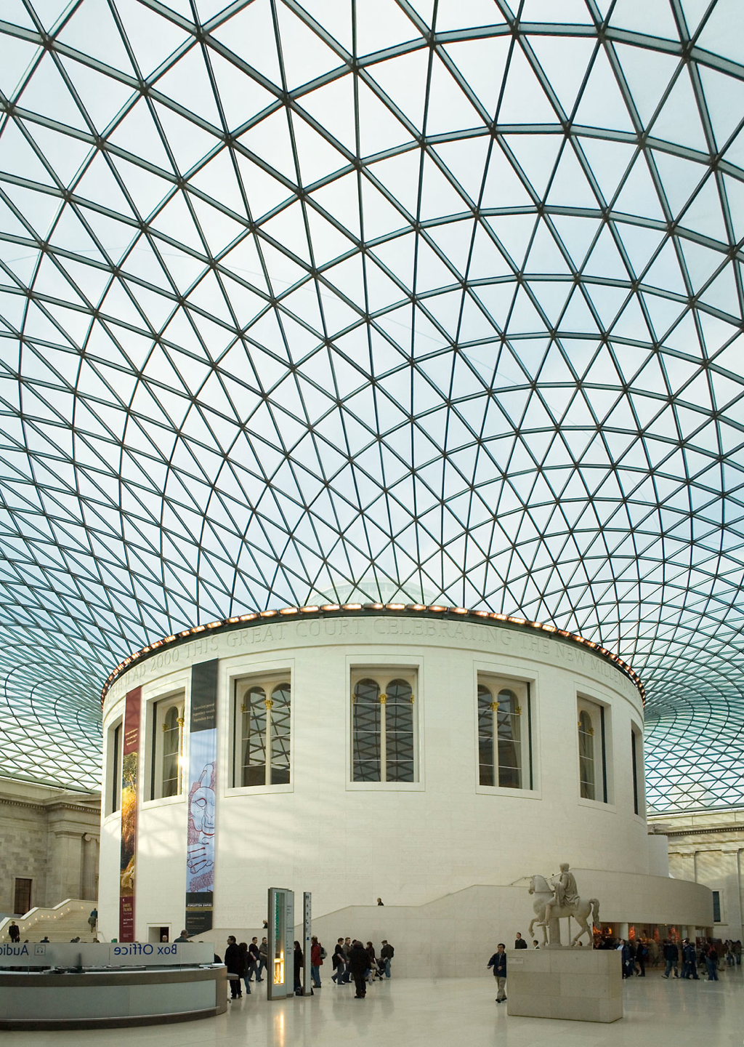
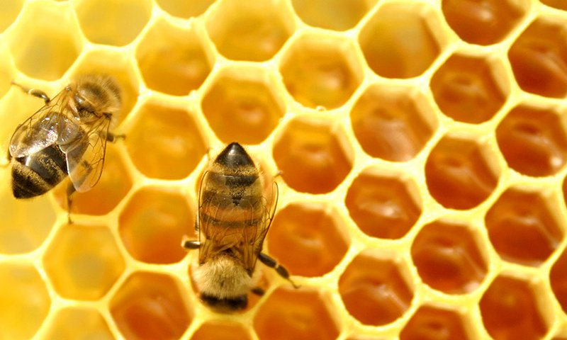
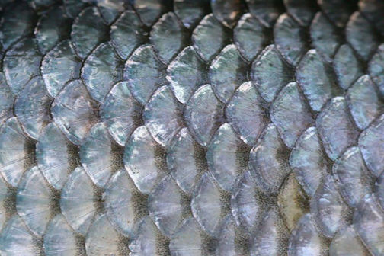
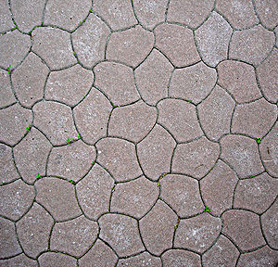
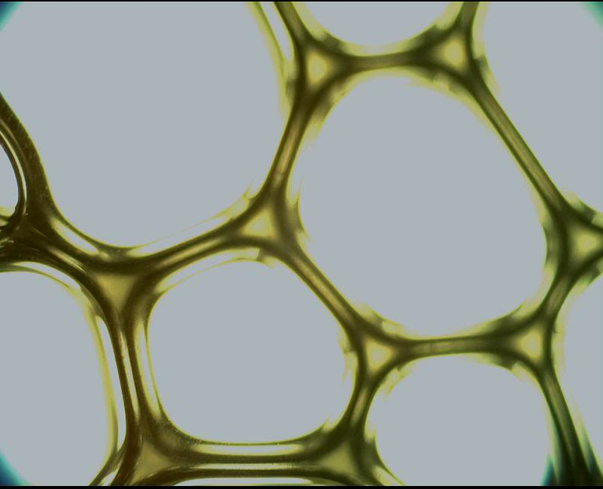
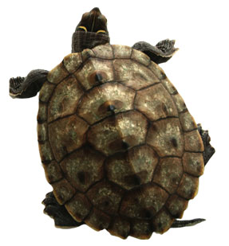
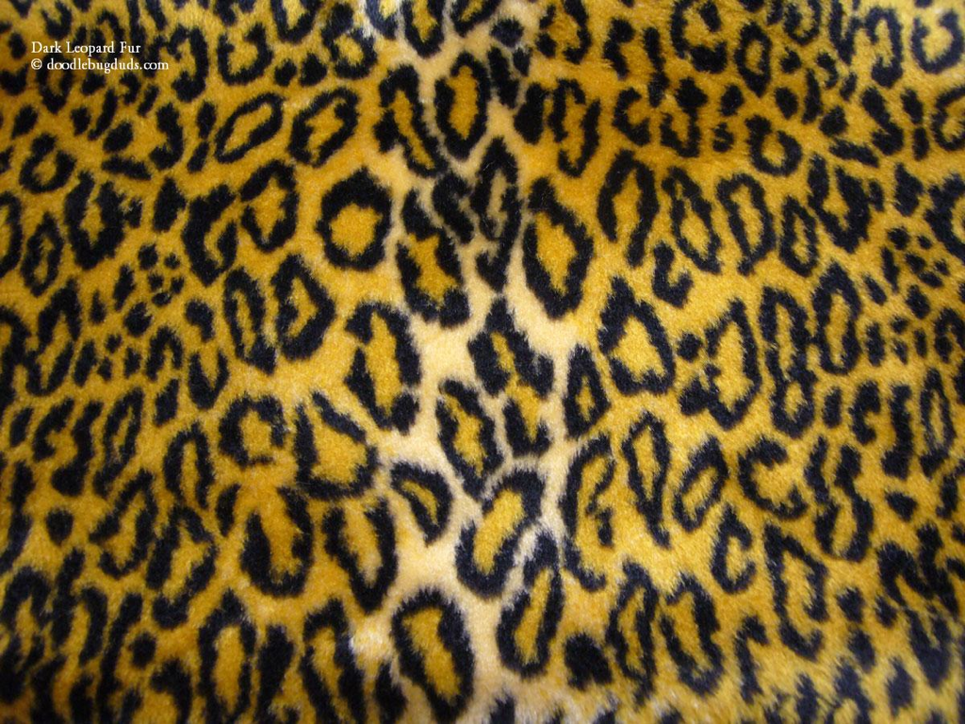
Tessellations all around us

Slide 4
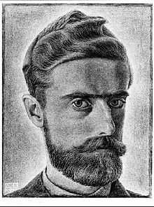
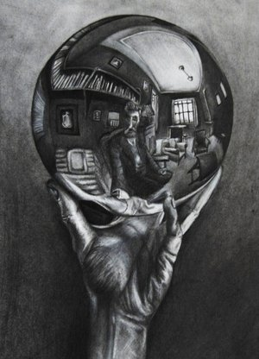
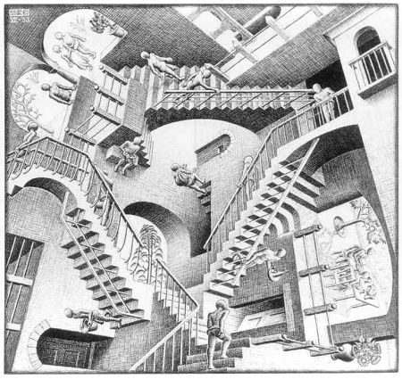
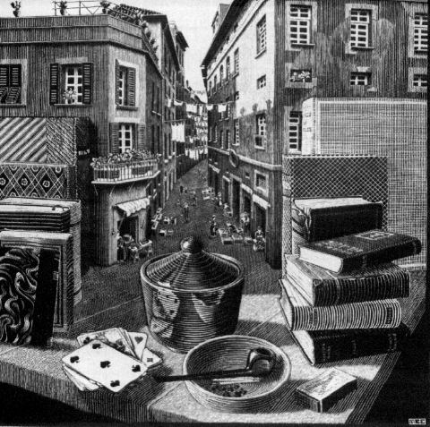
M.C. Escher
Artist known for his creative tessellations.
Born in Holland in 1898, died in 1972.
Created 137 tessellations in his lifetime.
Art work was very mathematical.
Combines realism with optical illusions and metamorphoses of one object into another

Slide 5
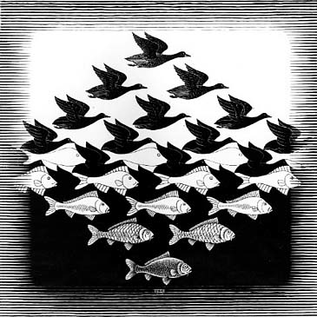
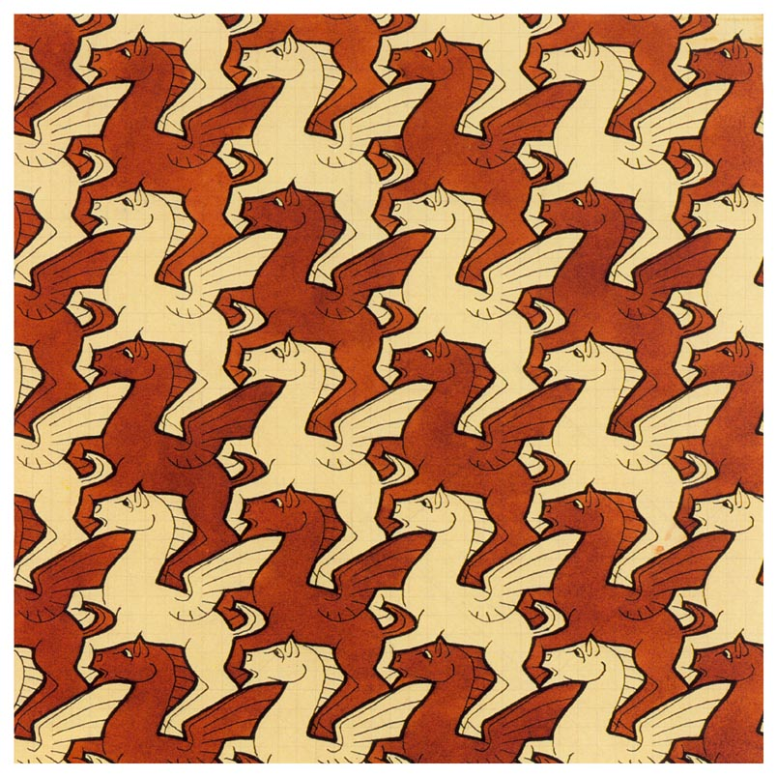
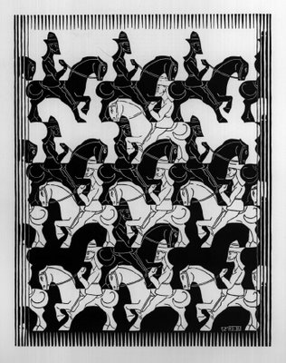
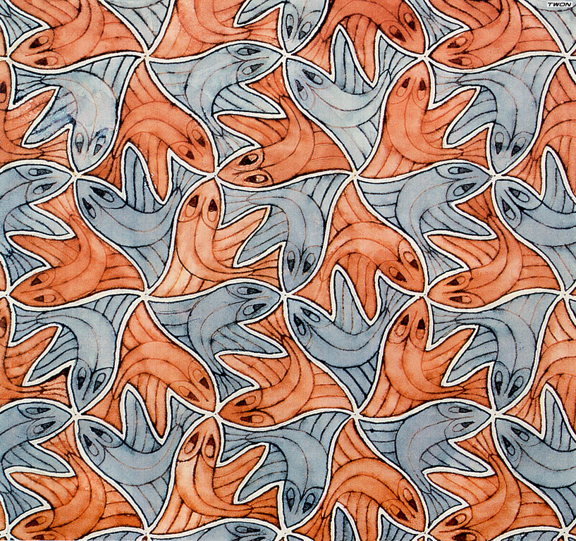
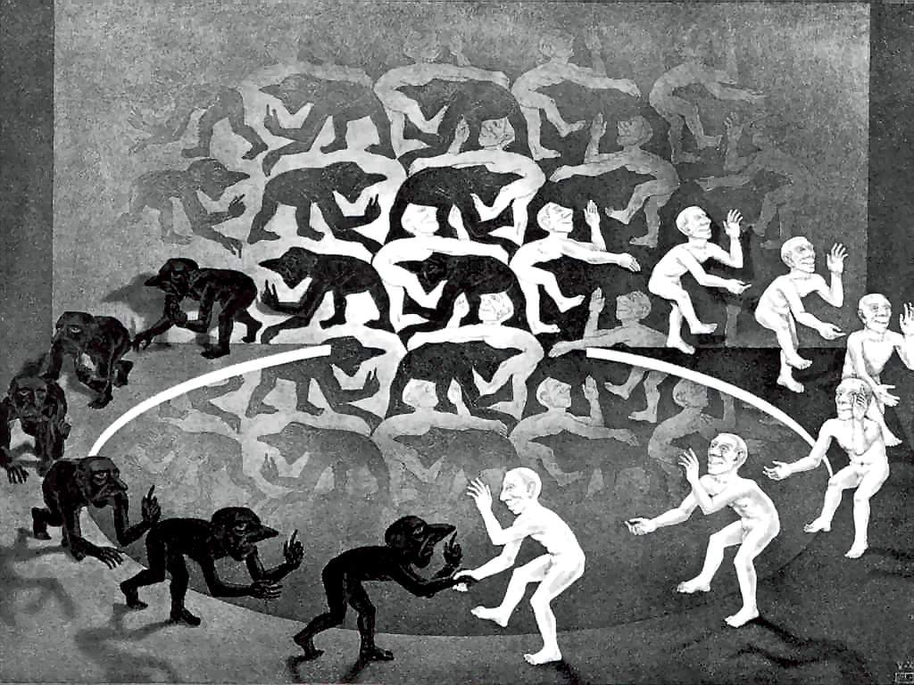
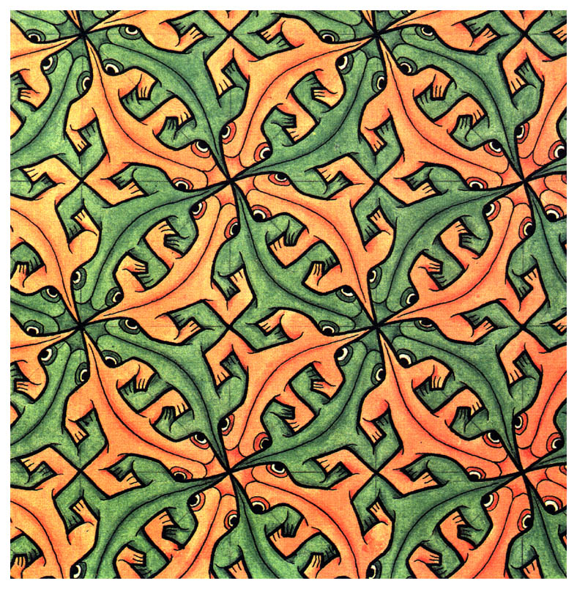

Slide 6
Repetition
This term refers to a way of combining elements of art so that the same elements are used over and over again.
A certain colour or shape might be used several times in the same picture.
Repetition also can contribute to movement and rhythm in a work of art.
It can give your composition a sense of balance and harmony.

